Slide 1
Classification of Car Sales Customers
Mini Project 3
David Muwandi
1 May 2021

Slide 2
AGENDA
Car sales overview
Business Question
Data Pipeline
EDA
Models & Evaluation
Summary
Questions

Slide 3
Overview
The Automotive industry is estimated to contribute $37 billion to the Australian economy, and as at May 2018 the industry employed over 356,000 Australians
Figures for 2020 showed a total of 916,968 vehicles were sold across the period, down 13.7% on calendar year 2019.
Decrease in sales in 2020 was attributed to COVID 19 pandemic.
How can a company maintain or grow sales despite a market down turn?

Slide 4
Business Question
Develop a model to classify potential customers into correct segment
Why is this important
Predicting the right segment for a potential customer will enable the right strategy to be applied i.e. pitching relevant products and desired packages.
Increase in sales volumes

Slide 5
DATA PIPELINE
Data
Acquisition
EDA & preprocessing
Report
Business
Question
Training & evaluation

Slide 6
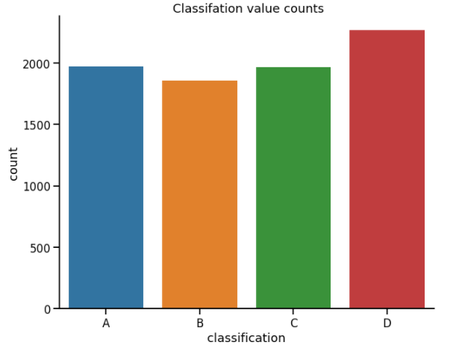
Data set
Source - Kaggel
8068 X 10
Multi classification
Balanced data set
Important Features
Age
Work Experience
Family Size
Profession
Spending Score

Slide 7
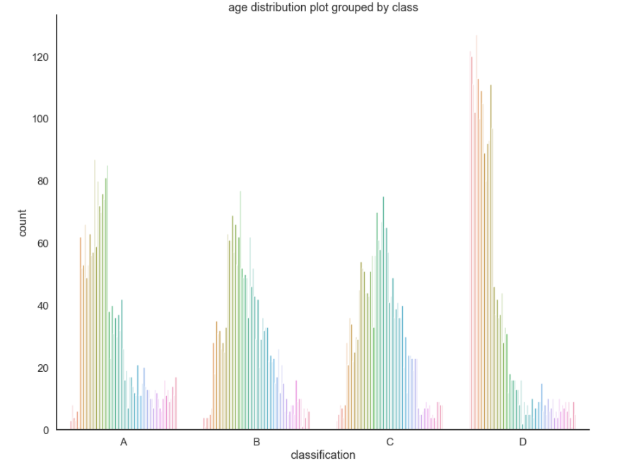
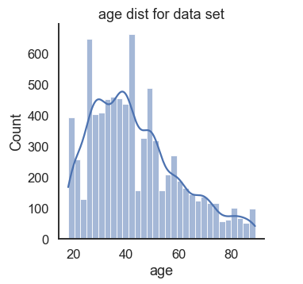
Age Distribution
Data set - left skewed
Segments A & B – left skewed
Segments B & C - normal

Slide 8
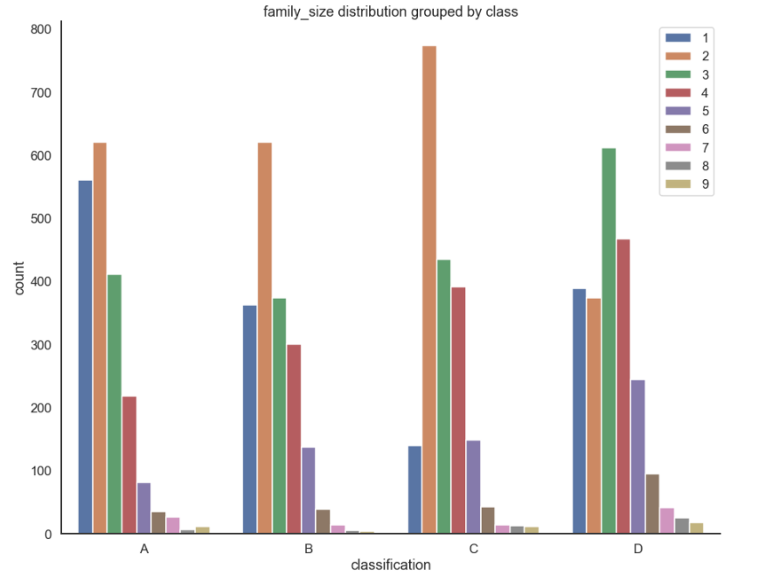
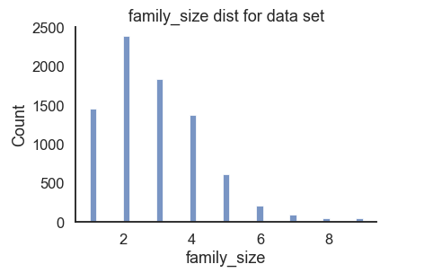
Family Size
Distribution is left skewed but shifting towards right from segment A - D

Slide 9
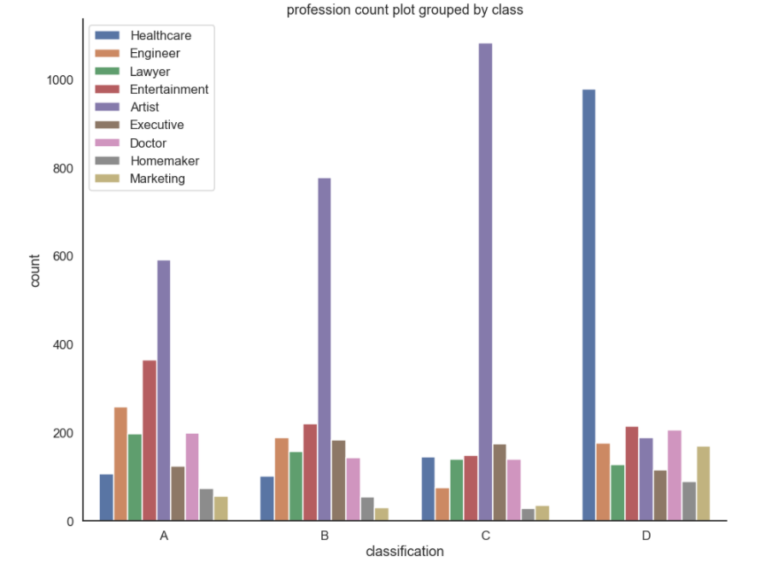
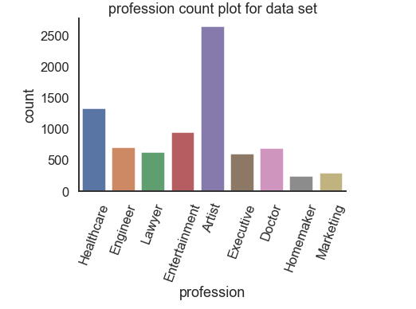
Profession
Health care workers dominate segment D
Artists dominate A, B, C segments

Slide 10
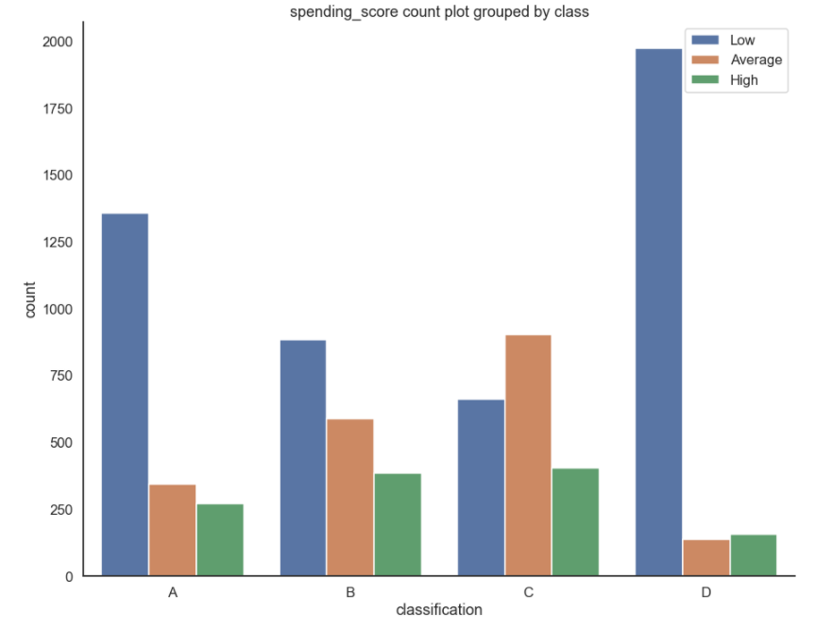
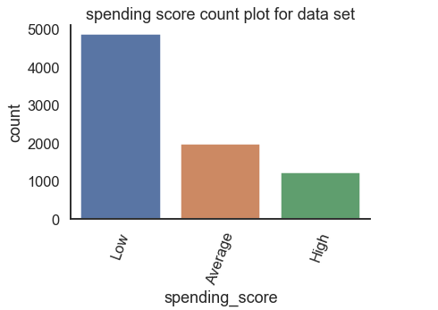
Spending Score
Segment C is dominated by ‘Average’ spending_score.

Slide 11
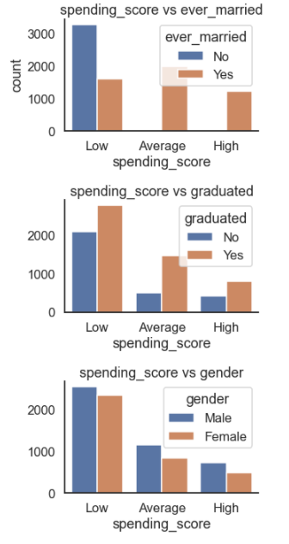
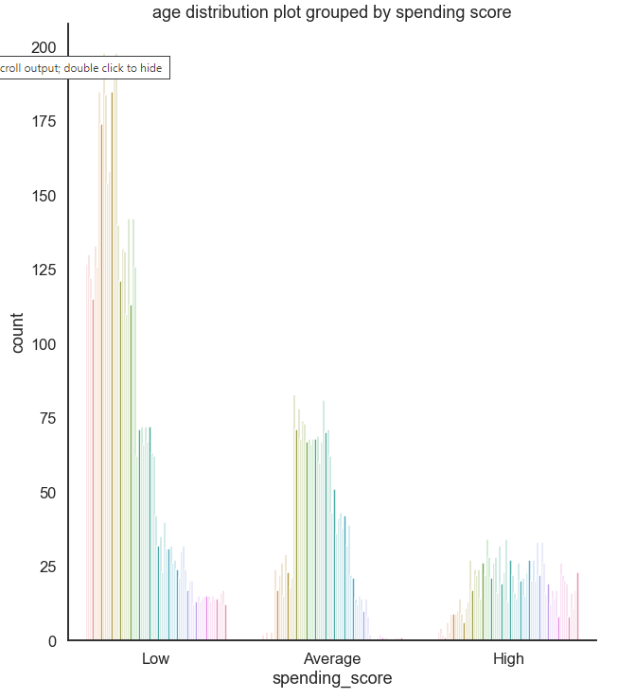
Spending Score
Never married – Low score
Graduated – higher score
Males – higher score
Low score – younger age
High score – uniform age

Slide 12
Training & Evaluation
Model | accuracy_score | Standard deviation | roc_auc_score
Bagging | 0.4777 | 0.03 | 0.7554
Stacking | 0.4455 | 0.01 | 0.7266
AdaBoosting | 0.4461 | 0.01 | 0.6992
Random Forrest | 0.3569 | 0.01 | 0.6284
KNN | 0.4108 | 0.02 | 0.6207
Decision Tree | 0.4083 | 0.02 | 0.6151
random Forrest_ important_features | 0.3562 | 0.02 | 0.6068
Models ranked in
order of roc_auc_score

Slide 13
Next Steps
Explore other pre-processing techniques e.g. Feature Engineering
Obtain more domain and business information to build on business case
Explore Deep learning neural network models

Slide 14
Summary
Bagging model with an accuracy of 75% developed
More work required to improve model performance
Questions

